Slide 1

MAJOR PROJECT
PERFORMANCE EVALUATION OF VAPOUR COMPRESSION REFERIGERATION SYSTEM WITH INTEGRATED MECHANICAL SUB-COOLING
Department of mechanical engineering
Group Members:
Abhishek Aggarwal (35114808220)
Arunav Sharma (75214808220)
Pawan Kumar (00514808220)
Amit Singh Bisht (00114808220)
Rishabh Jain (20114811119)
Narendra Singh (00414808220)
Under the Guidance of:
Dr. Vaibhav Jain

Slide 2
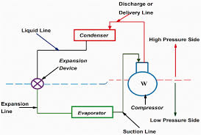
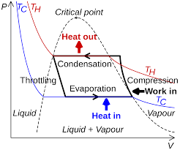
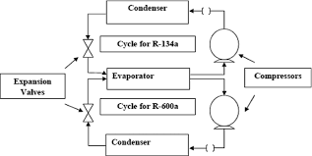
OBJECTIVES
Thermodynamic study of IVCRS
Development of experimental facility
Experimentation of IVCRS
Validation of actual COP of the experimental setup

Slide 3
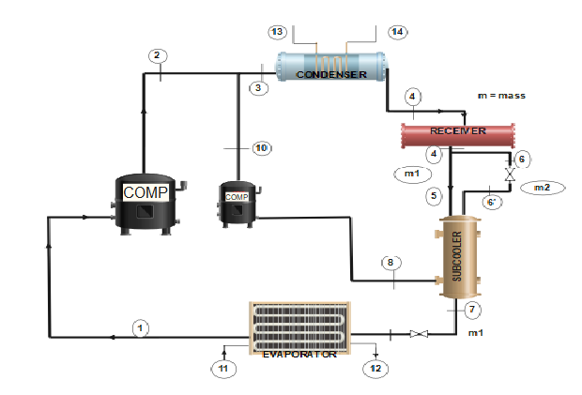
Integrated Vapour Compression Refrigeration System Cycle
There are Various methods of increasing the efficiency of VCRS which includes subcooling. It could be of various types but here we discuss about the IVCRS which is core of our study. The major component of an integrated mechanical subcooling vapour compression Refrigeration system includes two reciprocating compressors, two expansion valves, condenser, evaporator, receiver and a subcooler. The system consists of two simple cycle coupled to each other in such a way that they are combined they give better results in terms of power saving and increased refrigeration effect. The bigger cycle is known as the main cycle and the smaller cycle is known as the sub cooler cycle. The two cycle have a common condenser and components of all the two cycle are connected in a closed loop

Slide 4
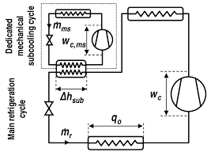
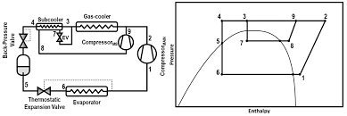
MECHANICAL SUBCOOLING
Using a mechanical sub-cooling loop is a way to improve cooling capacity and possibly save energy. Integrated mechanical subcooling is one of the types of subcooling and the other is dedicated mechanical .
INTEGRATED SUBCOOLING
In an integrated mechanical-subcooling vapor-compression refrigeration system, the subcooling is performed by utilizing a small integrated vapor-compression refrigeration cycle, known as the subcooler cycle.

Slide 5
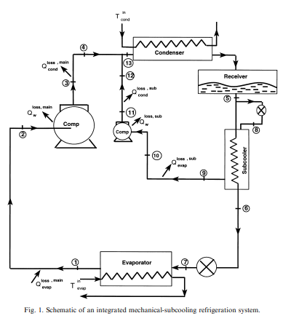
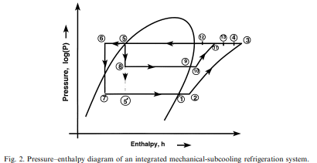
Cycle description of an integrated mechanical-
subcooling refrigeration system
The major components of an integrated mechanical subcooling vapor-compression refrigeration system includes two reciprocating compressors, two expansion valves, condenser, evaporator, receiver and a subcooler. The system consists of two simple cycles coupled to each other via a subcooler as shown in Fig. 1, while its pressure enthalpy diagram is shown in Fig. 2.

Slide 6
Literature Review and Survey
Literature review on dedicated sub cooling
●Exergy analysis of dedicated mechanically subcooled vapour compression refrigeration cycle using HFC-R134a, HFO- R1234ze and R1234y. By: Shyam Agarwal, Akhilesh Arora, and B. B. Arora
●Experimental energetic analysis of a vapour compression refrigeration system with dedicated mechanical subcooling. By: Bilal A, Qureshi, Muhammad Inam, Mohammed A. Antar and Syed M. Zubair.
●Dedicated subcooling design strategies for supermarket applications. By: J.W. Thornton, S.A. Klein, J.W. Mitchell
●The effect of refrigerant combination on performance of a vapour compression refrigeration system with dedicated mechanical subcooling. By: Bilal Ahmed Qureshi, Syed M. Zubair

Slide 7
Literature review on integrated subcooling
●Thermodynamic analysis of a vapour compression refrigeration system integrated with a subcooler cycle. By: Ranendra Roy and Bijan Kumar Mandal
●Design & rating of an integrated mechanical subcooling vapour compression refrigeration system. By: Jameel –ur-Rehman, Syed M. Zubair
●The impact of fouling on performance of a vapour compression refrigeration system integrated mechanical subcooling system. By: Bilal Ahmed Qureshi, Syed M. Zubair
●Thermoeconomic and feasibility analysis of novel transcritical vapour compression-absorption integrated refrigeration system. By: Vaibhav Jain and D. Colorado

Slide 8
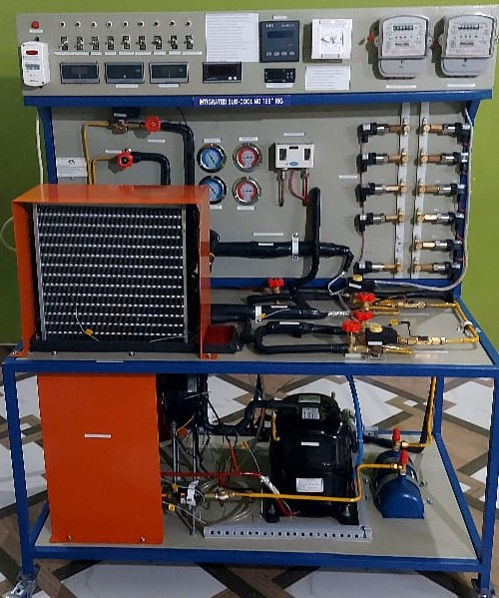
METHODOLOGY Fabrication of experimental setup
The focus will be on working of Vapour compression Refrigeration system with Integrated Mechanical subcooling. The explanation of Assumptions and relevant thermodynamic equations will be stated.
VCRS is a efficient way of refrigeration system used in modern period. There are Various methods of increasing the efficiency of VCRS which includes subcooling. It could be of various types but here we discuss about the IVCRS which is core of our study.

Slide 9
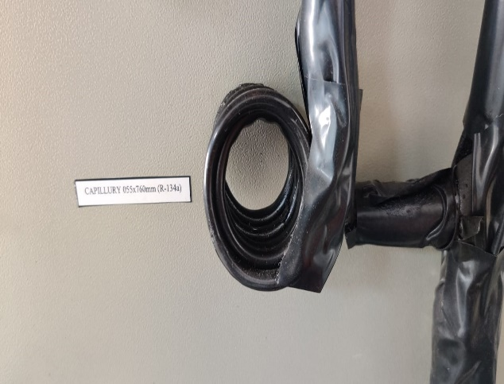
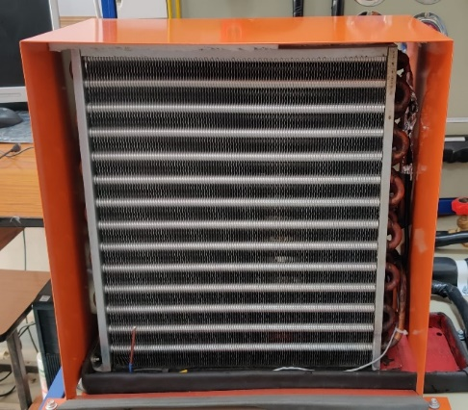
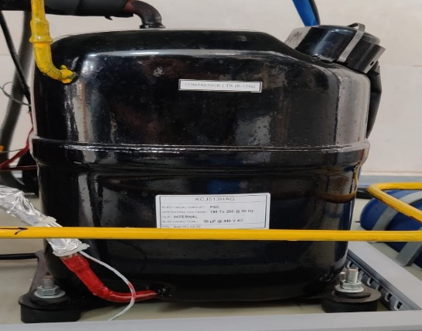
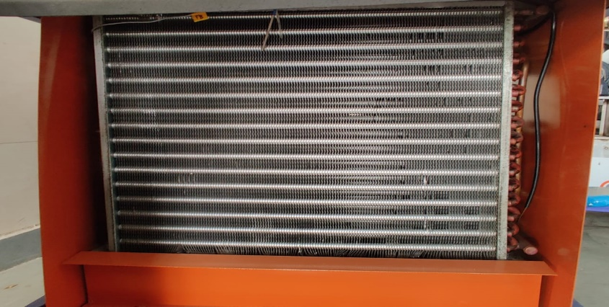
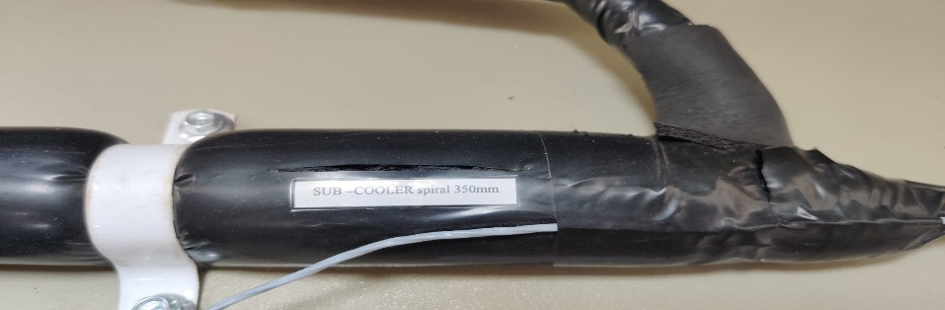
Fabrication of experimental setup
The present setup consists of 3 major categories of components
1. Main components
2. Auxiliary components
3. Instrumentation
Main components:-
1. Evaporator
2. Compressor
3. Condenser
4. Subcooler
5. throttling device
6. capillary

Slide 10
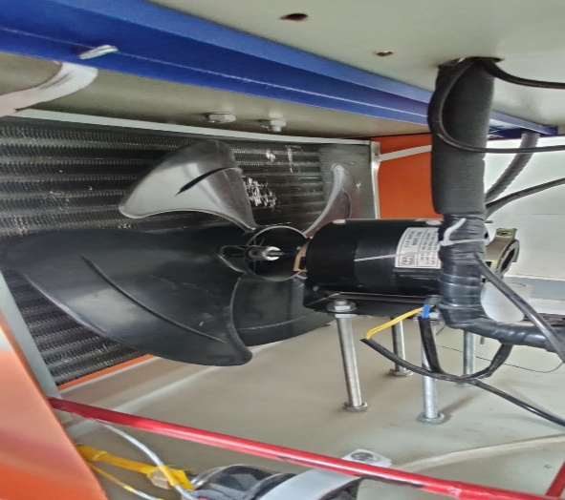
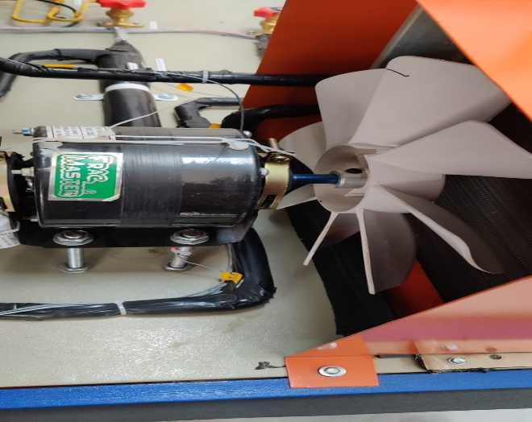
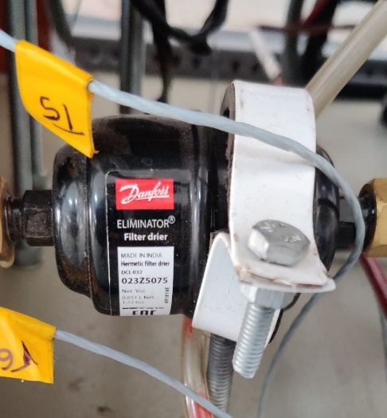
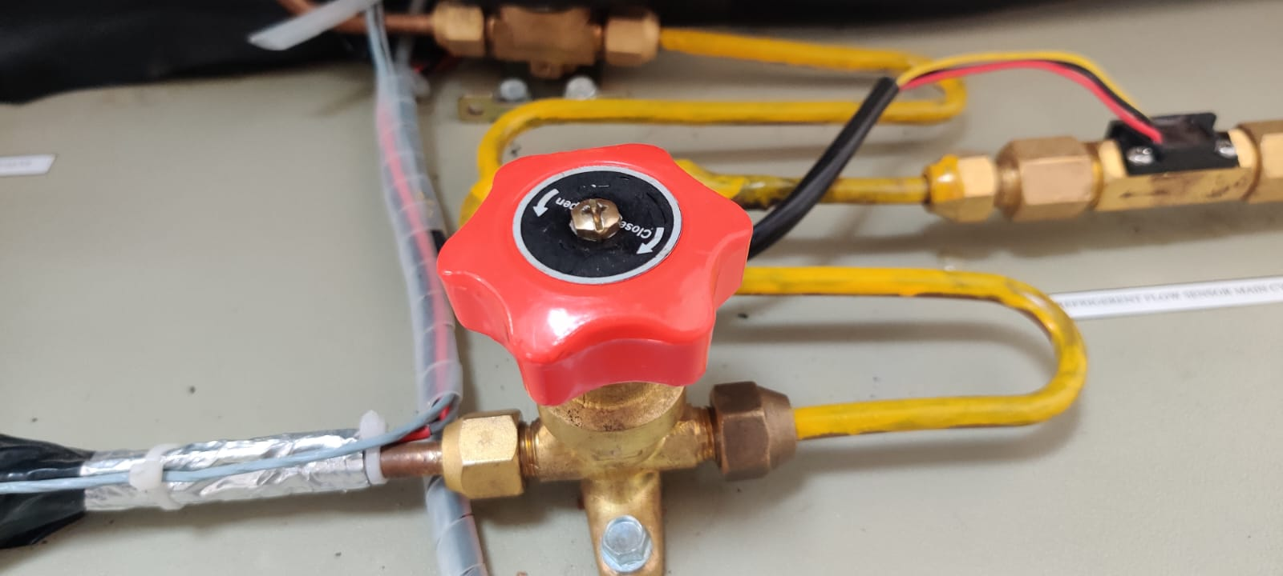
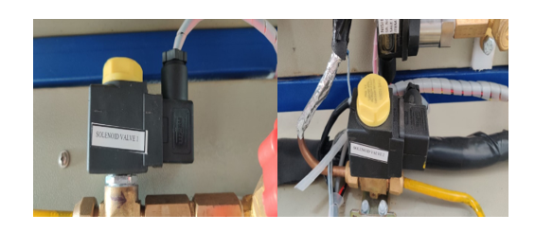
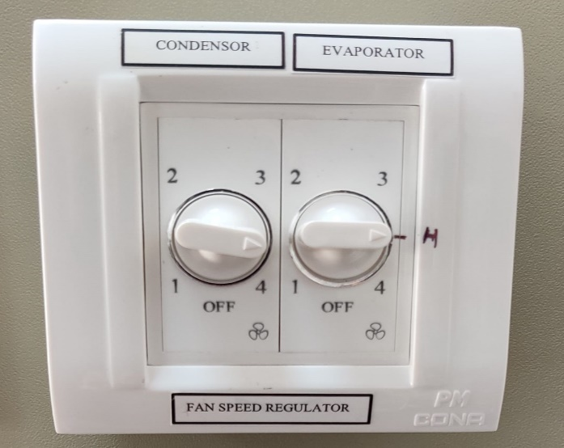
Auxiliary components:-
1. fans for evaporator and condenser
2. hand shut valves
3. solenoid valves
4. filter drier
5. sight glass
6. receiver tank
7. regulator for fans
9. refrigerant
10. insulation

Slide 11
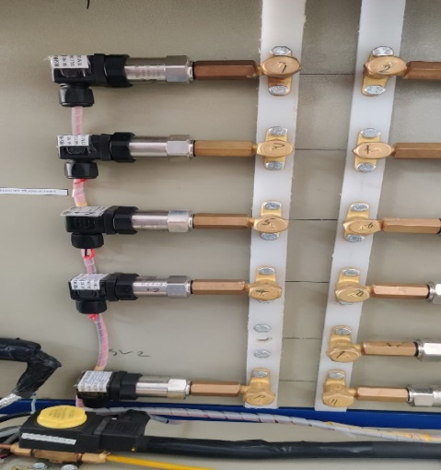
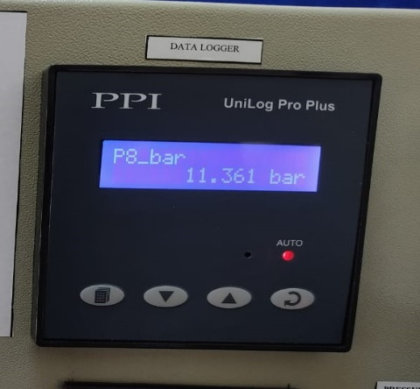
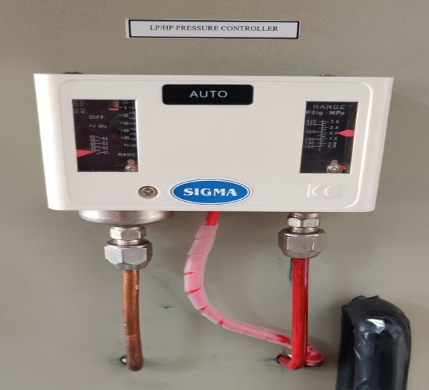
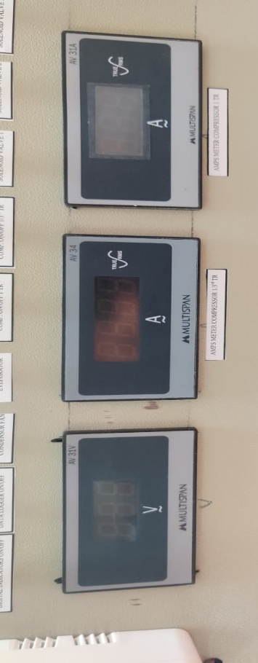
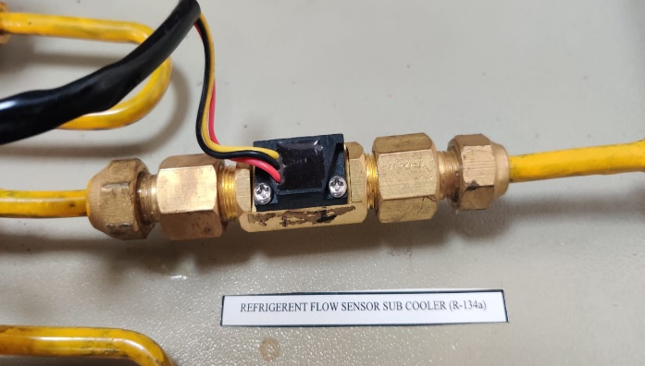
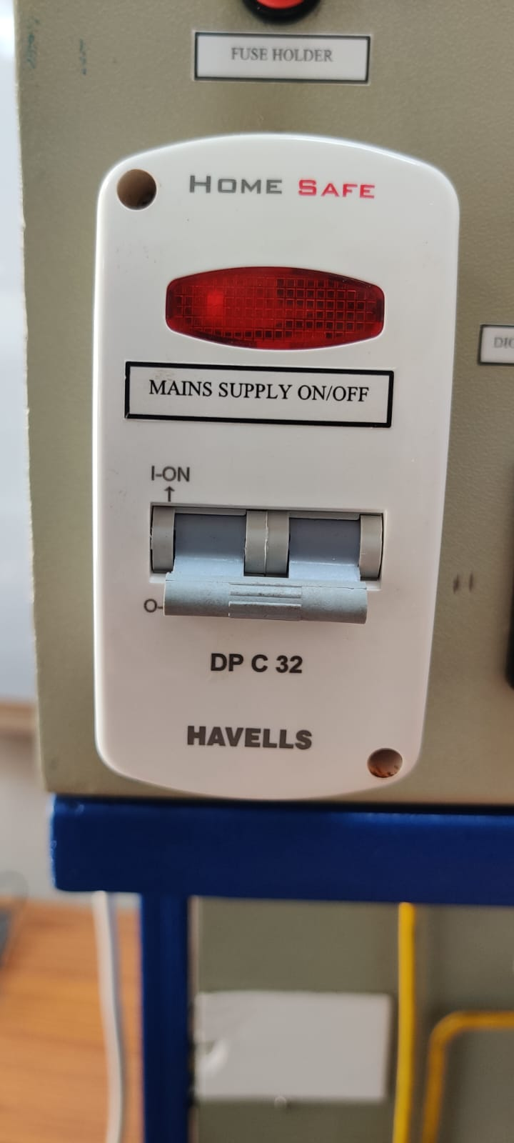
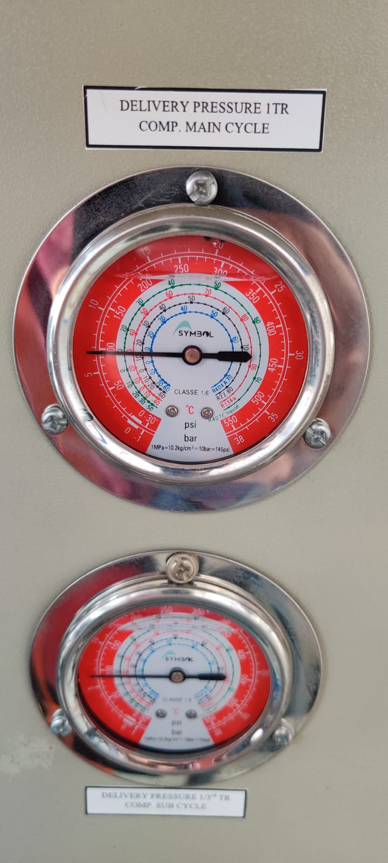
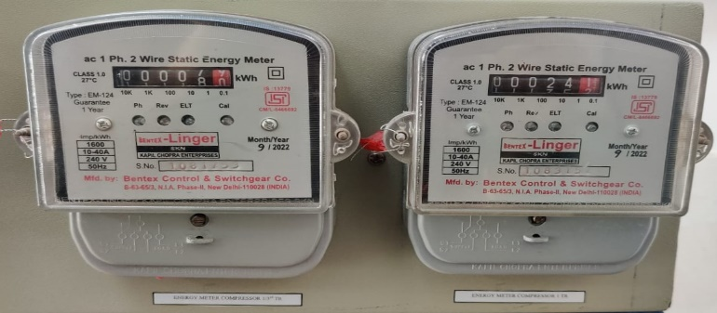
Instrumentation:-
1. temperature sensors
2. pressure transducers
3. mass flow sensors
4. energy flow meter
5. data aquisition system
6. overload protection switch
7. main supply on/off
8. fuse holder
9. all display units
10. analog pressure gauges

Slide 12
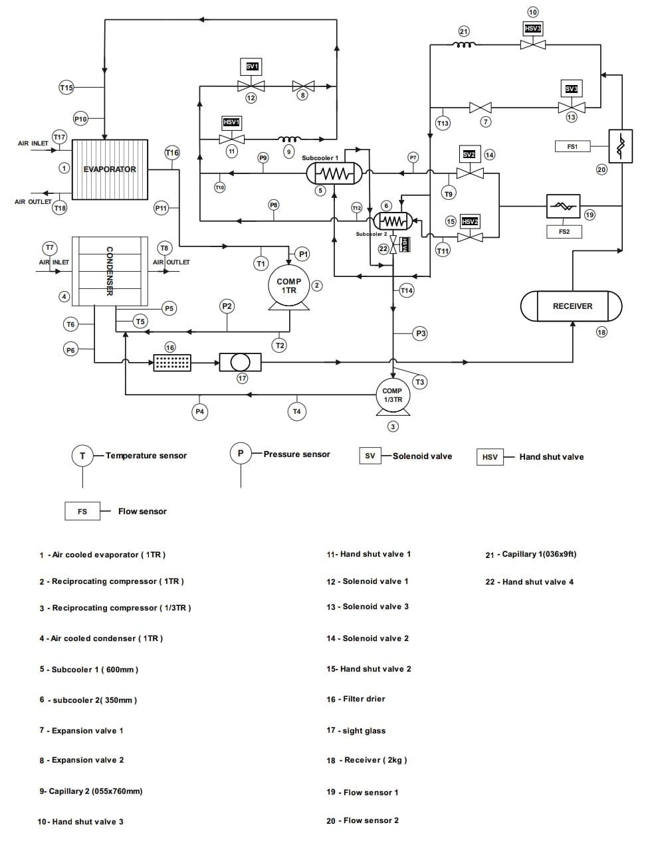
LINE DIAGRAM

Slide 13
Results & Discussions
While working on the experimental setup some of these configrations were observed:-
Configrations | SV1 | SV2 | SV3 | EV1(06X9 ft) | EV2(055X760 mm) | SC1(600mm) | SC2(350mm)
1.) | OFF | ON | OFF | ON | ON | ON | OFF
2.) | ON | ON | ON | OFF | OFF | ON | OFF
3.) | ON | ON | OFF | ON | OFF | ON | OFF
4.) | OFF | ON | ON | OFF | ON | ON | OFF
5.) | OFF | ON | OFF | ON | ON | OFF | ON
6.) | ON | ON | ON | OFF | OFF | OFF | ON
7.) | ON | ON | ON | OFF | OFF | OFF | ON
8.) | OFF | ON | ON | OFF | ON | OFF | ON

Slide 14
THERMODYNAMIC PARAMETERS OF EXPERIMENTAL SETUP
Following thermodynamic parameters are required to find the C.O.P of the expermiental
setup at various configrations
Confi- grations | Te (in) | Pe (in) | Te (out) | Pe (out) | h1 | Tc (in) | Pc (in) | Tc (out) | Pc (out) | h2 | Ts (in) | Ps (in) | Ts (out) | Ps (out) | h3 | C.O.P
1.) | 38 | 2.4 | 35 | 1.6 | 36 | 34 | 1.6 | 65 | 12 | 12 | 38 | 9.2 | 41 | 11 | - | 2.838
2.) | 14.9 | 5.76 | 21.4 | 3.24 | 69 | 14.7 | 1.21 | 93.6 | 15 | 5.4 | 53 | 15.5 | 48 | 15.8 | 5 | 3.12
3.) | 24.8 | 7.91 | 25.9 | 4.11 | 41 | 14.6 | 4.13 | 63.9 | 16.9 | 2 | 51.7 | 14.7 | 50.7 | 16.7 | .9 | 3.45
4.) | 25 | 8.1 | 24 | 4.1 | 183 | 22 | 6 | 91 | 18 | 51 | 14 | 4.1 | 67 | 17 | 27 | 2.323
5 10 5 26 2.9 207.85 28 6 99 16 57.8 -9 1.1 83 15 61.8 2.5

Slide 15
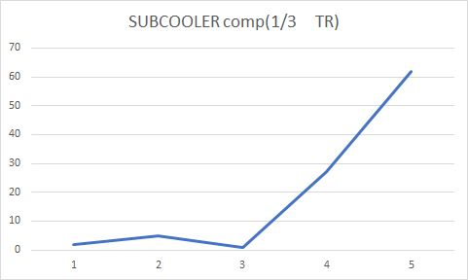
GRAPHICAL REPRESENTATION OF VARIOUS PARAMETERS
1› Compressor work of Subcooler cycle at difference configuration
This particular graph shows the trend how subcooler compressor work varies when the experimental setup is used on various configuration

Slide 16
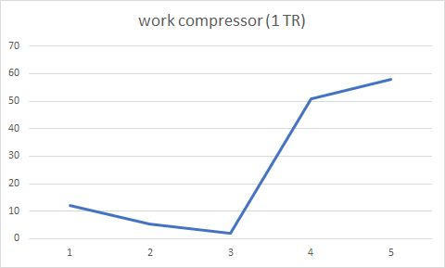
2›Compresser work change with respect to change in load on evaporator
This particular graph shows the variation in the compressor work of main cycle when the load on evaporator varies

Slide 17
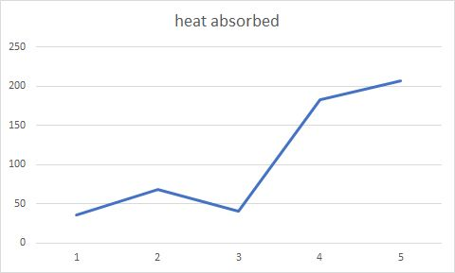
3› Amount of heat absorbed by evaporator
This graph shows the amount of heat absorb by evaporator at various configuration

Slide 18
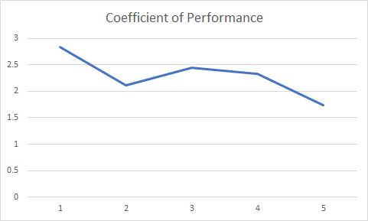
4› Variation of COP
This graph represent variation of COP at various configuration of experimental setup

Slide 19
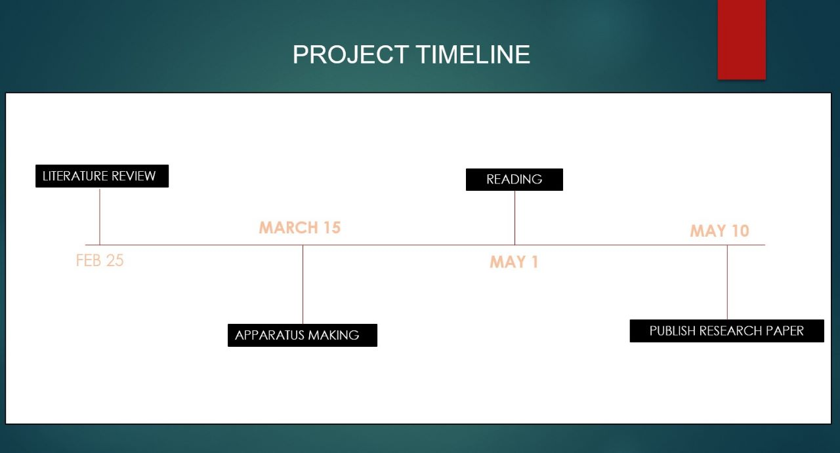
Project timeline
MAY 31

Slide 20


